Slide 1

Vectorized Reservoir Sampling
Shinji Ogaki
Notes:
I’m Shinji Ogaki. I’ll present vectorized reservoir sampling.

Slide 2
Background
ReSTIR
Notes:
For real-time rendering, ReSTIR is increasingly popular.

Slide 3
Background
ReSTIR
Resampled Importance Sampling
Weighted Reservoir Sampling
Notes:
It’s a streaming algorithm built on resampled importance sampling and weighted reservoir sampling. It can efficiently render direct lighting from many lights by reusing samples of neighboring pixels and past frames.

Slide 4
Background
ReSTIR
Resampled Importance Sampling
Weighted Reservoir Sampling
Direct illumination [Bitterli et al. 2020; Wyman and Panteleev 2021]
Grid based optimization [Boksansky et al 2021; Boissé 2021]
Global illumination [Ouyang et al. 2021]
Participating media [Lin et al. 2021]
Notes:
Recent extensions enable to render even global illumination and participating media.

Slide 5
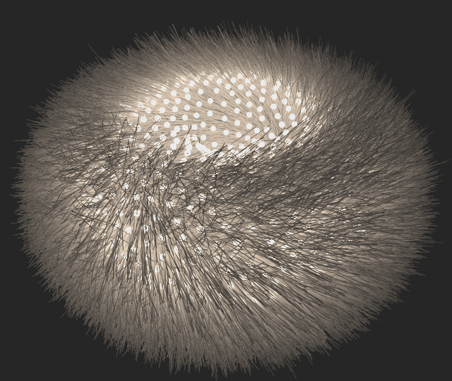
Goals
Make reservoir resampling useful for CPU offline rendering
Develop algorithm that works when
spatial reuse is difficult
temporal reuse is difficult (no previous frames)
Notes:
The aim of this small project is to make reservoir resampling more useful for CPU offline rendering, and to develop an algorithm that works when spatial and temporal reuse are difficult or impossible.

Slide 6
Weighted Random Sampling
Chao’s algorithm [Chao 1982]
Notes:
ReSTIR and its variants use Chao's weighted reservoir sampling because of its simplicity.

Slide 7
Chao’s Algorithm
Input : stream {W1, W2, …, WN}
Output: sample id I
Function Select({W1, W2, …, WN})
I ← 0
Wsum ← 0
for i ← 1 to N do
Wsum ← Wsum + Wi
if random() < Wi/Wsum then
I ← i
return I
Notes:
Here is the pseudocode.

Slide 8
Chao’s Algorithm
Input : stream {W1, W2, …, WN}
Output: sample id I
Function Select({W1, W2, …, WN})
I ← 0
Wsum ← 0
for i ← 1 to N do
Wsum ← Wsum + Wi
if random() < Wi/Wsum then
I ← i
return I
Notes:
This is an elegant algorithm, but it has a problem that every time a new sample arrives, a random number must be generated to decide whether to accept the sample or not.

Slide 9
Random Numbers
Chao’s algorithm : O(N)
Jumps technique [Efraimidis 2015] : O(log(N))
Notes:
So, we need as many random numbers as the length of a stream N. Efraimidis used the jumps technique to reduce the number of random numbers to the order of log(N). But we still need many random numbers for long streams.

Slide 10
Sample Warping
Sample warping [McCool and Harwood 1997] : O(1)
Notes:
This problem can be easily addressed by using sample warping.

Slide 11
Chao’s Algorithm with Explicit Warping
Input : stream {W1, W2, …, WN}
: random number ξ
Output: sample id I
Function Select({W1, W2, …, WN}, ξ)
I ← 0
Wsum ← 0
for i ← 1 to N do
Wsum ← Wsum + Wi, p ← Wi/Wsum
if ξ < p then
I ← i, ξ ← ξ/p
else
ξ ← (ξ-p)/(1-p)
return I
Notes:
This is the pseudocode of Chao's algorithm modified with sample warping.

Slide 12
Chao’s Algorithm with Explicit Warping
Input : stream {W1, W2, …, WN}
: random number ξ
Output: sample id I
Function Select({W1, W2, …, WN}, ξ)
I ← 0
Wsum ← 0
for i ← 1 to N do
Wsum ← Wsum + Wi, p ← Wi/Wsum
if ξ < p then
I ← i, ξ ← ξ/p
else
ξ ← (ξ-p)/(1-p)
return I
Notes:
As you can see, only one random number is required to select a sample from a stream.

Slide 13
Chao’s Algorithm with Explicit Warping
Input : stream {W1, W2, …, WN}
: random number ξ
Output: sample id I
Function Select({W1, W2, …, WN}, ξ)
I ← 0
Wsum ← 0
for i ← 1 to N do
Wsum ← Wsum + Wi, p ← Wi/Wsum
if ξ < p then
I ← i, ξ ← ξ/p
else
ξ ← (ξ-p)/(1-p)
return I
Notes:
I call this “explicit warping” because the random number is directly manipulated.

Slide 14
Chao’s Algorithm with Explicit Warping
Explicit warping is also used in “Light Sampling in Quake 2 Using Subset Importance Sampling” by Zirr
Notes:
The same idea is also used in the concurrent work “Light Sampling in Quake 2 Using Subset Importance Sampling”.

Slide 15
Chao’s Algorithm with Implicit Warping
Is it possible to check
only with ?
Notes:
In explicit warping, the given random number is stretched multiple times. I wondered if it would be possible to use a single random number but without modifying it at all.

Slide 16
Chao’s Algorithm with Implicit Warping
Notes:
Actually, it’s possible with simple calculations.

Slide 17
Chao’s Algorithm with Implicit Warping
r
c
Notes:
[click] With these two relationships used for explicit sample warping [click], and two auxiliary sequences [click], we can rewrite the condition in this way. This looks complex but don’t worry because the actual implementation is rather simple.

Slide 18
Chao’s Algorithm with Implicit Warping
Input : stream {W1, W2, …, WN}
: random number ξ
Output: sample id I
Function Select({W1, W2, …, WN}, ξ)
I ← 0, Wsum ← 0, r ← 0, c ← 0
for i ← 1 to N do
Wsum ← Wsum + Wi, p ← Wi/Wsum
if ξ < r + cp then
I ← i, c ← cp
else
r ← r + cp, c ← c(1-p)
return I
r
c
Notes:
The differences are in the updating of the two variables “r” and “c” and in the conditional statement.

Slide 19
Explicit versus Implicit
Not clear which is better
Notes:
Now we have two options that only use a single random number, but it's not clear which one is more accurate.

Slide 20
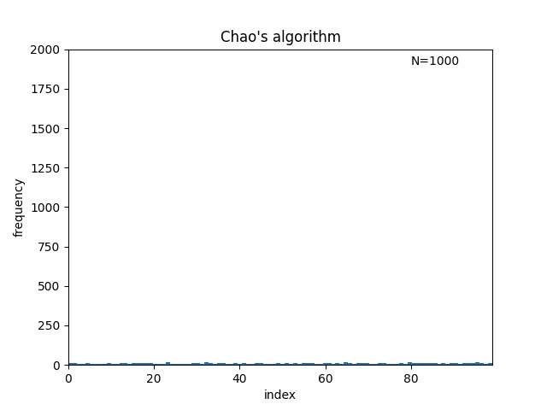
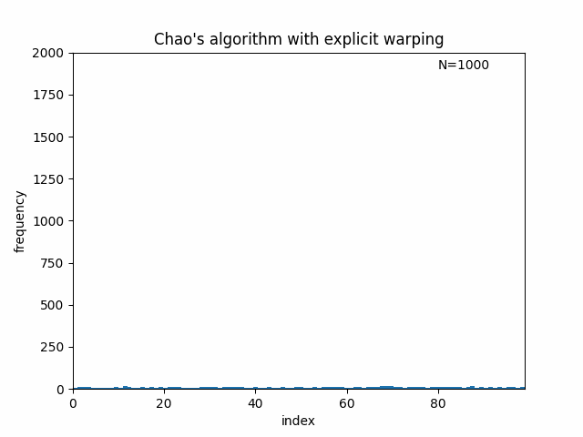
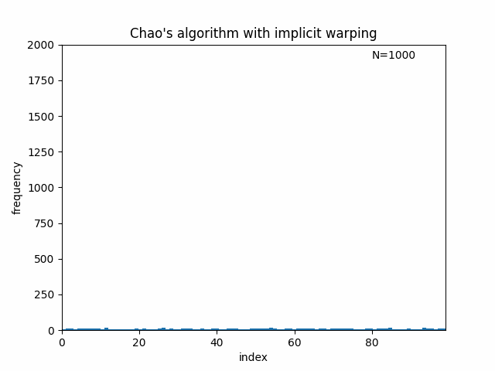
Explicit versus Implicit
Experiment (1)
Stream of length 100 {1, 1, 1, 1, … , 1}
100,000 samples
Original
Explicit
Implicit
Notes:
So, I performed simple tests by feeding a stream of samples with a constant weight. In the first experiment, I set the length of the stream 100 and generated 100,000 samples to plot histograms. These histograms are roughly flat as expected. In other words, generated samples are uniformly distributed.

Slide 21
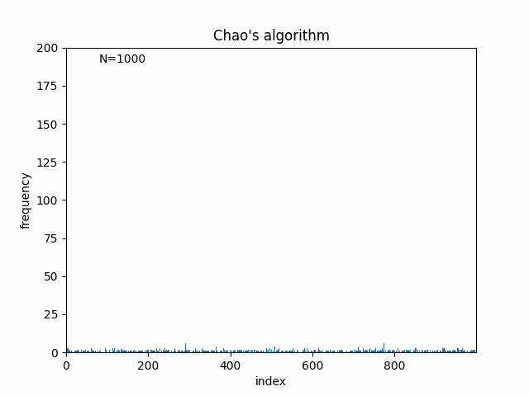
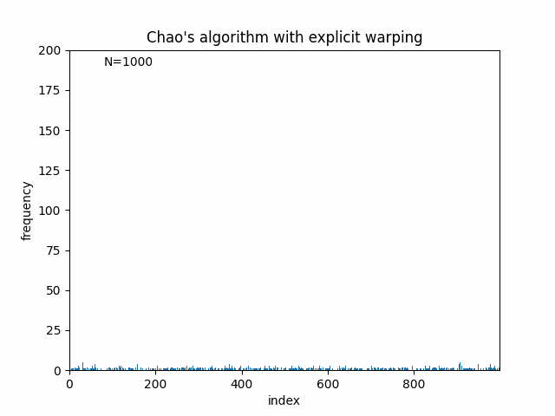
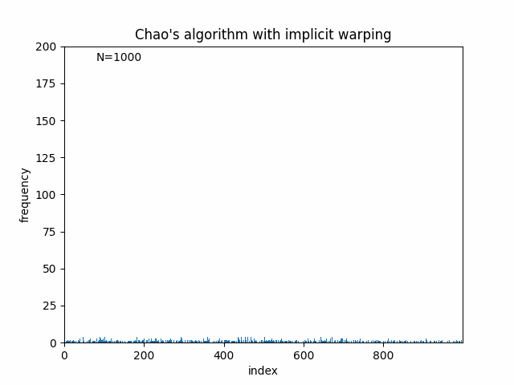
Explicit versus Implicit
Experiment (2)
Stream of length 1,000 {1, 1, 1, 1, … , 1}
100,000 samples
Original
Explicit
Implicit
Notes:
Next, I made the stream ten times longer. The histogram generated using implicit warping is no longer flat even though all samples have the same weight. So why is this happening?

Slide 22
Chao’s Algorithm with Implicit Warping
Input : stream {W1, W2, …, WN}
: random number ξ
Output: sample id I
Function Select({W1, W2, …, WN}, ξ)
I ← 0, Wsum ← 0, r ← 0, c ← 0
for i ← 1 to N do
Wsum ← Wsum + Wi, p ← Wi/Wsum
if ξ < r + cp then
I ← i, c ← cp
else
r ← r + cp, c ← c(1-p)
return I
Notes:
The reason is simple. The variable “c” decreases quickly and monotonically [click], and “p” also tends to decrease. [click] So, the floating-point number “r” will soon stop changing. Therefore, I recommend using explicit warping. Unfortunately, the implicit reformulation has no practical use, but it helps to understand the relation with the jumps technique.

Slide 23
Chao’s Algorithm with Implicit Warping
Input : stream {W1, W2, …, WN}
: random number ξ
Output: sample id I
Function Select({W1, W2, …, WN}, ξ)
I ← 0, Wsum ← 0, r ← 0, c ← 0
for i ← 1 to N do
Wsum ← Wsum + Wi, p ← Wi/Wsum
if ξ < r + cp then
I ← i, c ← cp
else
r ← r + cp, c ← c(1-p)
return I
Notes:
The reason is simple. The variable “c” decreases quickly and monotonically [click], and “p” also tends to decrease. [click] So, the floating-point number “r” will soon stop changing. Therefore, I recommend using explicit warping. Unfortunately, the implicit reformulation has no practical use, but it helps to understand the relation with the jumps technique.

Slide 24
Chao’s Algorithm with Implicit Warping
Input : stream {W1, W2, …, WN}
: random number ξ
Output: sample id I
Function Select({W1, W2, …, WN}, ξ)
I ← 0, Wsum ← 0, r ← 0, c ← 0
for i ← 1 to N do
Wsum ← Wsum + Wi, p ← Wi/Wsum
if ξ < r + cp then
I ← i, c ← cp
else
r ← r + cp, c ← c(1-p)
return I
Notes:
The reason is simple. The variable “c” decreases quickly and monotonically [click], and “p” also tends to decrease. [click] So, the floating-point number “r” will soon stop changing. Therefore, I recommend using explicit warping. Unfortunately, the implicit reformulation has no practical use, but it helps to understand the relation with the jumps technique.

Slide 25
Chao’s Algorithm with Implicit Warping
Input : stream {W1, W2, …, WN}
: random number ξ
Output: sample id I
Function Select({W1, W2, …, WN}, ξ)
I ← 0, Wsum ← 0, r ← 0, c ← 0
for i ← 1 to N do
Wsum ← Wsum + Wi, p ← Wi/Wsum
if ξ < r + cp then
I ← i, c ← cp
else
r ← r + cp, c ← c(1-p)
return I
Jumps technique [Efraimidis 2015]
Notes:
In fact, the jumps technique is a partial use of implicit warping. Efraimidis only used implicit warping only when a sample is rejected. If you are using the jumps technique, you may want to switch to explicit warping.

Slide 26
Vectorization
Notes:
Now we’ve seen that a single random number is sufficient to select a sample from a stream.
This makes it easy to vectorize Chao’s algorithm.

Slide 27
Vectorization
Input stream is divided into multiple disjoint substreams
Notes:
Vectorization can be done by splitting an input stream into multiple disjoint substreams.

Slide 28
Vectorization
Input stream is divided into multiple disjoint substreams
Make the best use of SIMD units
Notes:
By doing so, we can use SIMD units to process all substreams simultaneously.

Slide 29
Vectorization
Input stream is divided into multiple disjoint substreams
Make the best use of SIMD units
Numerical errors can be reduced by using short substreams
Notes:
And using wide SIMD units makes the length of each substream one order of magnitude shorter, so we can reduce numerical errors.

Slide 30
Vectorization
Total weight of each substream should be equal
input stream
Notes:
There is one thing to keep in mind when splitting the input stream. Ideally, each substream should have an equal total weight.

Slide 31
Vectorization
Total weight of each substream should be equal
substream 0
substream 1
substream 2
substream 3
Notes:
So instead of dividing the stream in this way,

Slide 32
Vectorization
Total weight of each substream should be equal
input stream
Notes:
So instead of dividing the stream in this way,

Slide 33
Vectorization
Total weight of each substream should be equal
substream 0
substream 1
substream 2
substream 3
Notes:
So instead of dividing the stream in this way,

Slide 34
Vectorization
Total weight of each substream should be equal
substream 0
substream 1
substream 2
substream 3
Notes:
use interleaved sampling.

Slide 35
Vectorization
Total weight of each substream should be equal
input stream
Notes:
use interleaved sampling.

Slide 36
Vectorization
Total weight of each substream should be equal
substream 0
substream 1
substream 2
substream 3
Notes:
use interleaved sampling.

Slide 37
Vectorization
Scan all substreams simultaneously
substream 0
substream 1
substream 2
substream 3
Notes:
Once the substreams have been scanned, the reservoir associated with each substream holds a single sample.

Slide 38
Vectorization
Scan all substreams simultaneously
substream 0
substream 1
substream 2
substream 3
Notes:
Once the substreams have been scanned, the reservoir associated with each substream holds a single sample.

Slide 39
Vectorization
Scan all substreams simultaneously
substream 0
substream 1
substream 2
substream 3

Slide 40
Vectorization
Scan all substreams simultaneously
substream 0
substream 1
substream 2
substream 3
Notes:
And we select one based on the sum of weights stored in each reservoir.

Slide 41
Applications 1: Single Scattering
xl
tmin
xt
tmax
Notes:
Lastly, I’ll show you a couple of practical examples. In the first example, vectorized reservoir sampling is applied to compute single scattering. The target function here is the integrand excluding the visibility term.

Slide 42
Applications 1: Single Scattering
xl
1/(tmax-tmin)
tmin
xt
tmax
Notes:
And the source pdf is a uniform distribution.

Slide 43
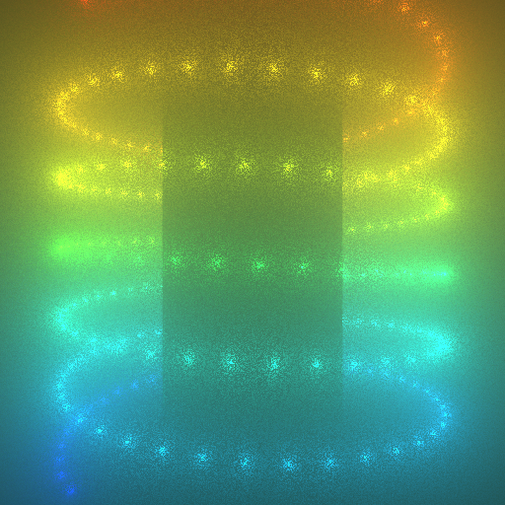
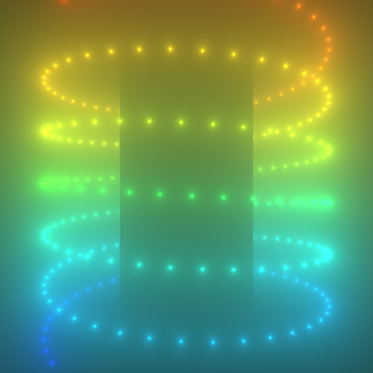
Applications 1: Single Scattering
Equi-angular sampling 6.0sec
[Kulla and Fajardo 2012]
Ours 5.7sec
Notes:
In this scene, 256 point lights are placed in a strongly forward scattering participating medium. The left image is rendered using equi-angular sampling which does not take into account the phase function

Slide 44
Applications 1: Single Scattering
Equi-angular sampling 6.0sec
[Kulla and Fajardo 2012]
Ours 5.7sec
Notes:
The right image rendered with our method has less noise because the phase function is included in the target function.

Slide 45
Applications 2: Direct Illumination
A
xl
xs
Notes:
In the next example, vectorized reservoir sampling is applied to compute the direct illumination from a triangular light source.

Slide 46
Applications 2: Direct Illumination
Xl′
A
xs
Notes:
If the emitter and BRDF are Lambertian, the un-shadowed illumination can be computed analytically, and the equation can be reformulated as the ratio estimator. By using the geometric term as the target function, we can perform projected solid angle sampling. Here, vectorized reservoir sampling is only used to pick a sample point on the triangle.

Slide 47
Applications 2: Direct Illumination
Xl′
1/A
xs
Notes:
The source pdf is again a uniform distribution.

Slide 48

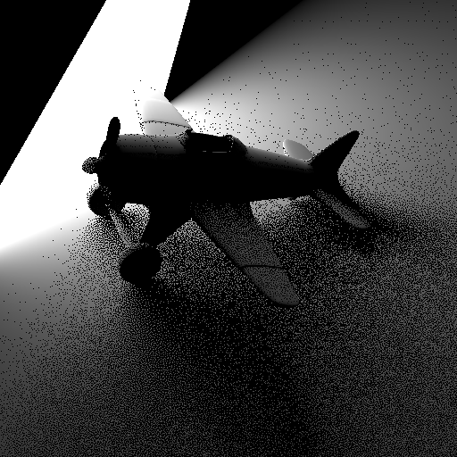
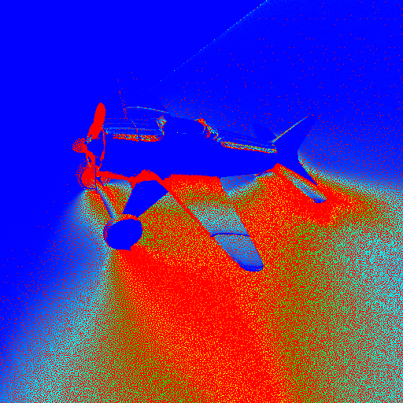
Applications 2: Direct Illumination
Reference (Path Tracing)
32768spp
Peters [2021] (Author’s code w/z glm)
1spp, 24msec
SMAPE
0.383
Notes:
Now let’s see the result. The middle image is rendered with the state-of-the-art method by Peters.

Slide 49
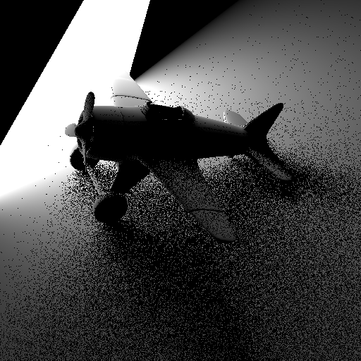
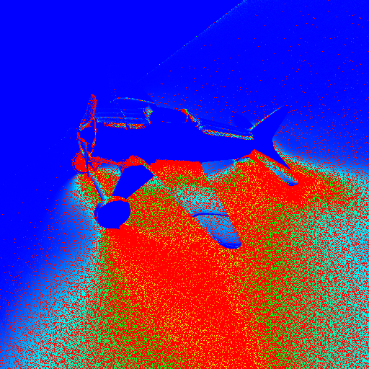
Applications 2: Direct Illumination
Reference (Path Tracing)
32768spp
Ours
1spp, 24msec
SMAPE
0.378
Notes:
And this is the result of the ratio estimator with vectorized reservoir sampling. To my surprise, for this specific scene and setting, I obtained a slightly lower SMAPE value.

Slide 50
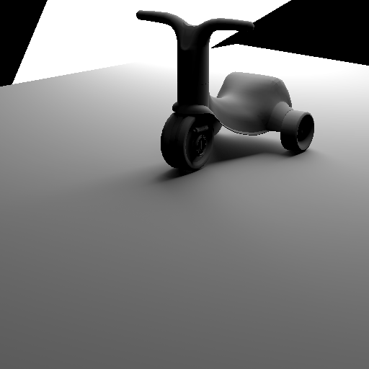
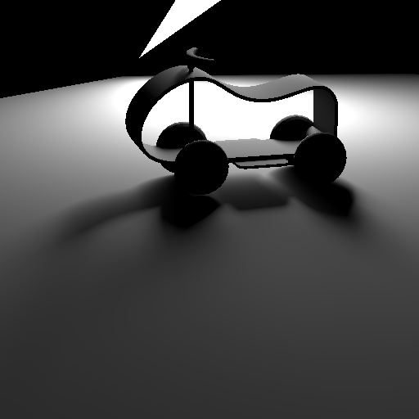
SMAPE
Peters
Ours
Notes:
In general, our method is slightly inferior to the method by Peters, but the implementation is way simpler.

Slide 51

Applications 2: Direct Illumination
Notes:
And the illumination from a sphere light can also be computed with a minor code modification.

Slide 52
Conclusion & Future Work
Notes:
To conclude,

Slide 53
Conclusion & Future Work
Vectorized Chao’s algorithm
Using sample warping (explicit warping)
Notes:
Chao’s weighted reservoir sampling is vectorized using sample warping, more specifically explicit warping.

Slide 54
Conclusion & Future Work
Vectorized Chao’s algorithm
Using sample warping (explicit warping)
Two practical examples
Single scattering
Direct illumination (ratio estimator + reservoir sampling)
Notes:
A couple of practical examples are given. I do not argue that vectorized reservoir sampling should be used instead of state-of-the-art algorithms, but it may be nice to have in your toolbox, if you are working on a CPU renderer.

Slide 55
Conclusion & Future Work
Vectorized Chao’s algorithm
Using sample warping (explicit warping)
Two practical examples
Single scattering
Direct illumination (ratio estimator + reservoir sampling)
Reduce numerical errors (e.g., by changing scanning order)
Notes:
In the future work, I’d like to improve numerical robustness, for example, by changing the scanning order.

Slide 56
Conclusion & Future Work
Vectorized Chao’s algorithm
Using sample warping (explicit warping)
Two practical examples
Single scattering
Direct illumination (ratio estimator + reservoir sampling)
Reduce numerical errors (e.g., by changing scanning order)
Multiple Importance Sampling
Notes:
It would be interesting to find an efficient way to evaluate pdfs for samples generated by other methods.

Slide 57
ありがとう
Notes:
That’s about it. Thank you for your attention.

